Slide 1
TableSat Overview
Jean-Baptiste Jeannin
University of Michigan
jeannin@umich.edu

Slide 2
TableSat: 1-DOF Satellite Simulator
ω

Slide 3
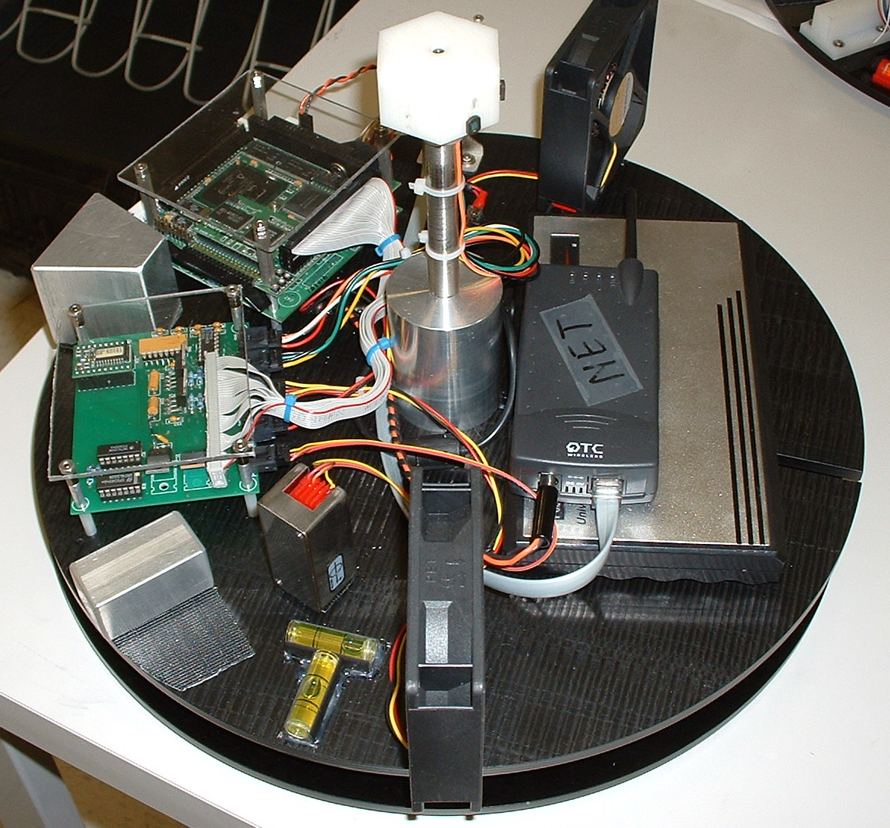
TableSat Primary Components
PC/104 stack
Sensor interface/ motor driver board (incl. magnetometer)
Rate gyro
+ fan (+ torque)
- fan (- torque)
Wifi unit
Battery unit
Sun sensors (CSS)
8
5
1
6
2
7
3
4

Slide 4
TableSat: Computing System
Diamond Systems 100MHz Athena PC/104 board + Jupiter power supply (www.diamondsystems.com)
QNX 6.2.1 O/S
DSCUD (Diamond Systems Corp. Universal Driver) utilities used for data acquisition
Battery pack runs TableSat for 7-8 hours

Slide 5
Hardware Interfaces: A/D, D/A, Counters
Athena A/D used in “channel scan” mode (see read_ad example code – it reads rate gyro only)
CH 0: Rate Gyro
CH 1: Magnetometer (x)
CH 2: Magnetometer (y)
CH 3: Magnetometer (z)
CH 4: Coarse Sun Sensor (CSS) – 1
CH 5: CSS – 2
CH 6: CSS – 3
CH 7: CSS – 4
Athena D/A used to command fans (see command_fan example code)
Counters connected to +/- fan tachometers (not used currently)

